Slide 1
CRM ANALYTICS

Slide 2
LIST OF KPI’S
OPPORTUNITY
LEAD
Expected Amount
Active Opportunities
Conversion Rate
Win Rate
Loss Rate
Trend Analysis
Running Total: Expected vs Commit Forecast
Running Total: Active vs Total Opportunities
Closed Won vs Total Opportunities
Closed Won vs Total Closed
Expected Amount by Opportunity Type
Opportunities by Industry
Total Leads
Expected Amount from Converted Leads
Conversion Rate
Converted Accounts
Converted Opportunities
Leads by Source
Leads by Industry

Slide 3



TOOLS USED IN DATA ANALYSIS
EXCEL
POWER BI
MYSQL

Slide 4
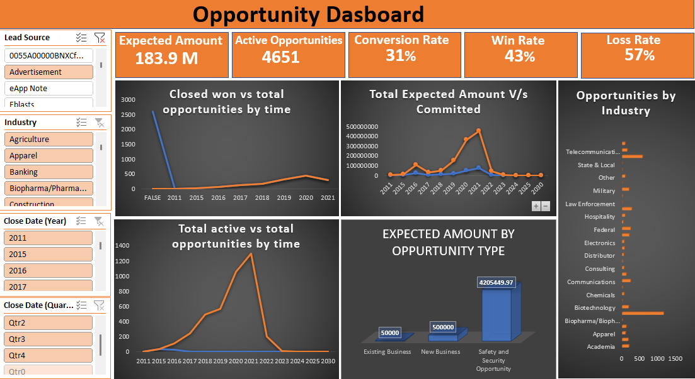
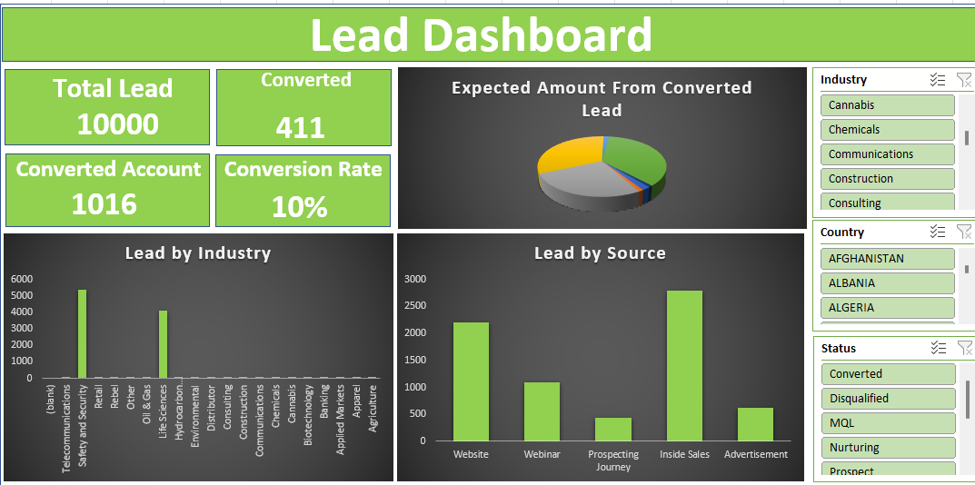
EXCEL DASHBOARD

Slide 5
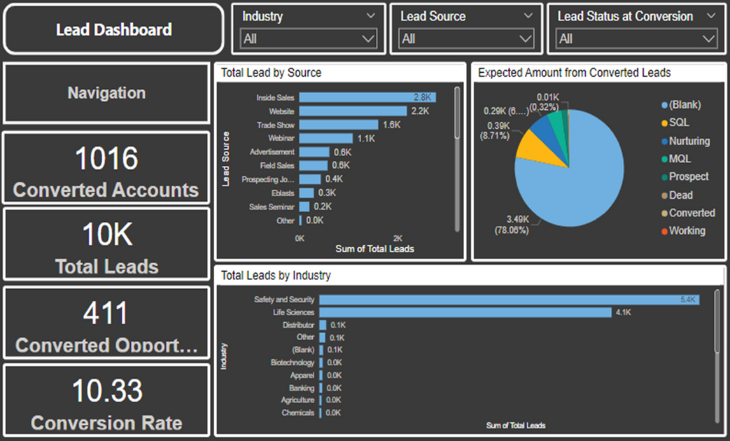
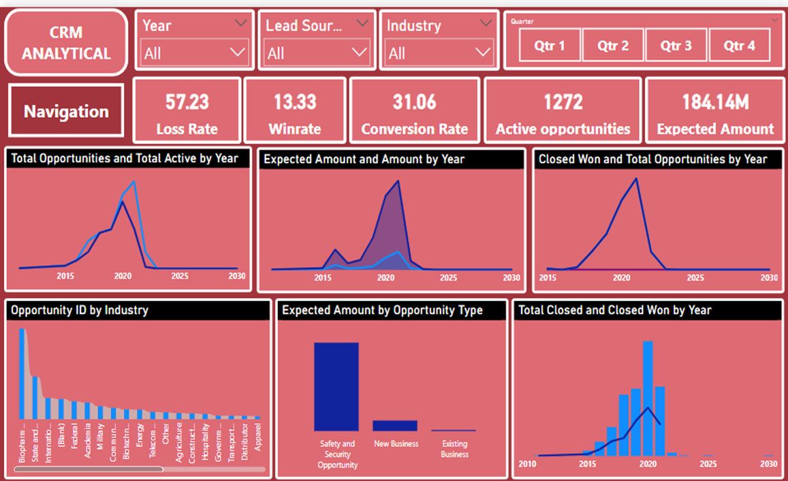
POWER BI DASHBOARD

Slide 6
MYSQL QUERIES
1. TOTAL LEADS
select count(*) as total_lead_count from lead_table;
select * from total_lead;
2. CONVERSION RATE
select (sum(case when converted = "true" then 1 else 0 end) * 1.0 / count(`lead id`)) * 100 as conversion_rate from lead_table;
select * from conversion_rate;
3. CONVERTED ACCOUNT COUNT
select count(case when `converted account id` is not null then 1 else null end) as converted_account_count from lead_table;
select * from converted_account;
4. DEBUG CONVERTED OPPORTUNITY
select `converted opportunity id`, case when `converted opportunity id` <> 0 then 1 else null end as match_check from lead_table;
select * from debug_converted_opportunity;
5. CONVERTED OPPORTUNITIES
select count(case when `converted opportunity id` <> 0 then 1 else null end) as converted_opportunity from lead_table;
select * from converted_opportunity;

Slide 7
6. LEADS BY SOURCE
select `lead source`, count(`lead id`) as total_leads
from lead_table group by `lead source`;
select * from lead_by_source;
7. LEADS BY INDUSTRY
select`industry`, count(`lead id`) as total_lead from lead_table
group by `industry`;
select * from lead_by_industry;
8. TOTAL EXPECTED AMOUNT FROM CONVERTED LEADS
select sum(`expected amount`) as total_expected_amount from lead_table
left join `oppertuninty table` on (`converted opportunity id` = o.`opportunity id` or `converted account id` = o.`account id`) where `converted opportunity id` is not null;
select * from total_expected_amount_from_converted;

Slide 8

THANK YOU

